Slide 1


The Federal Evaluation Toolkit
Evidence for Action: Presenting a Case for Evaluation
20 Minute Version: Time for Discussion

Slide 2

Evaluation is a Tool to Answer Questions
20 Minute Version: Time for Discussion
Are we meeting our objectives and reaching our goals?
Evidence to show success
Justify funding requests
Continuous quality improvement
What works, for whom, under what circumstances, and why?
Do we have the right people in the right places?
How can we improve processes or workstreams?
Notes:
Evaluation can answer specific types of questions that are important for your agency or program to answer.
Evaluation answers questions about efficiency and effectiveness
Answer questions about your program
Provide insights into program process and implementation
Explore new programs and approaches
Build evidence to make decisions
Acknowledgements: OMB.

Slide 3
Evaluating Factors Influencing Flood Insurance Coverage for Single-Family Homes in Two States (Pilot)
20 Minute Version: Time for Discussion
Questions about Implementation
Examine the number and proportion of homes located in Special Flood Hazard Areas (SFHAs) that have mortgages secured by the Federal Housing Authority (FHA).
Using National Flood Insurance Program (NFIP) data, determine whether FHA single-family home mortgages in SFHAs comply with FHA requirement to carry flood insurance.
Explore the relationship between flood insurance coverage and premiums, claims against NFIP, and loan performance.
Selected Findings
Percentage of FHA single-family properties inside SFHAs were relatively small compared with those outside SFHAs, although exposure to flood risk in 2019 was much higher in Florida (about 20%) than in North Carolina (about 5%).
On average, flood insurance coverage rate was significantly larger for properties with FHA-insured mortgages inside an SFHA than those outside an SFHA.
Flood insurance coverage does not significantly matter when determining default rates for FHA-insured properties inside or outside an SFHA.
Notes:
Two case studies illustrate the value of evaluation:
To identify how programs work
To assess program impact
The first case is of the Federal Housing Administration’s Flood Insurance Coverage program for Single-Family Homes.
Department of Housing and Urban Development : “Flood Insurance Coverage of Federal Housing Administration (FHA) Single-Family Homes,” 2M Research, March 2020.^{[vii]} This study combined three datasets: HUD’s quarterly extracts of single-family mortgage insurance data, Federal Emergency Management Agency’s (FEMA) property-level National Flood Insurance Program database, and FEMA flood maps. This descriptive analysis indicated that many FHA-insured mortgages are located in high-risk flood zones. Even though program regulations require nearly all properties located in such high-risk flood zones to be covered by flood insurance, the data indicate that a substantial share of these loans do not have, nor continuously maintain such insurance coverage. However, it should be noted that some of these properties may not require mandatory flood insurance due to property improvements, such as elevation, and could follow FHA’s regulations without carrying flood insurance. Further, HUD does not regularly gather information about the status of each property’s flood insurance coverage. The analysis was made possible only through a special data sharing agreement with FEMA that allowed HUD to gain access to a single point-in-time dataset of flood insurance policies.
Source: https://www.huduser.gov/portal/sites/default/files/pdf/MDRT-Flood-Insurance-Coverage-of-FHA-SFH.pdf

Slide 4
Evaluating Impact: Multi-Site Evaluation of Pathways for Advancing Careers and Education (PACE) The Administration for Children and Families (ACF) conducted the Pathways for Advancing Careers and Education (PACE) evaluation of nine career pathways programs. The evaluation team recruited programs providing occupational and training programs and randomly assigned participants to either treatment or control groups to determine the impacts of services provided by the programs under evaluation.
20 Minute Version: Time for Discussion
Questions about Impact
Does the program increase educational attainment and earnings? (I-BEST)
Does the program boost nurse-training enrollment for Hispanic/Latino population in Chicago? (Carreras en Salud)
Do the original and next innovation of programs increase and sustain earnings for participants? (Year Up)
Selected Findings
I-BEST → No detectable impacts on educational attainment or earnings
Carreras en Salud → Doubled credentialing rate for Hispanic/Latino healthcare workers and increased earnings
Year Up → Increased and sustained earnings for participants
Notes:
The second case comes from the Administration for Children and Family’s Office of Planning, Research, and Evaluation
In 2007, ACF partnered with Abt Associates to initiate a multi-site, randomized controlled trial (RCT) evaluation of programs geared to increase employment and economic independence among low-income individuals and families. The evaluation team for the project -- entitled PACE -- selected nine programs mainly focusing on innovative skills-development, education, vocational training, and occupational training. Participants in each program were randomly assigned to control groups and treatment groups to determine if the programs’ intervention models and strategies were effective at increasing and securing employment opportunities. Program leaders were also directed to participate in peer-to-peer engagements for knowledge-sharing and cross-pollination. Through these engagements, program leaders were able to learn about strategies that proved to be effective and efficient, as well as those that proved to be ineffective and inefficient across programs, communities, and populations served. Follow-up for the study occurred in three phases: the first at 18-months post-implementation, the second at 3 years post-implementation, and the third at 6 years post-implementation. Rounds of reports were developed after each follow-up and the data from the multi-site evaluation is archived through the Child and Family Data Archive under Pathways for Advancing Careers and Education Evaluation.
The nine evaluated programs are:
Des Moines Areas Community College (Workforce Training Academy Connect)
I-Best Programs in Washington State
Instituto del Progreso Latino (Carreras en Salud)
Madison Area Technical College (Patient Care Pathway Program)
Pima Community College (Pathways to Healthcare)
Sad Diego Workforce Partnership (Bridge to Employment in the Healthcare Industry)
Valley Initiative for Development and Advancement
Workforce Development Council of Seattle-King County (Health Careers for All)
Year Up
“We get a Chance to Show Impact,” Program Staff Reflect on Participating in a Rigorous, Multi-site Evaluation Download Report PDF (341.34 KB) – This research brief explores reflections from program leaders and staff that participated in the PACE evaluation. Initially, interested parties (referred to as stakeholders in the report) and program personnel showed reticence to engage in the evaluation. Concerns arose over the ethics of a randomized controlled trial and the potential of leaving the control group without services from the program. To address this concern, services were not withheld from participants in the control group; rather, they were provided with information to seek services and supports elsewhere. The researchers could then isolate the strategies put forth by the programs under evaluation and determine their role in increased educational attainment (i.e., degrees, licenses, and certificates) and employment security. Ensuring the power of the study was a critical component to determining causality between program services and employment security. Programs were required to ‘scale up’ by recruiting more participants (using additional funds from the PACE contract and Open Society Foundations), thereby serving more people than they had prior to the evaluation. They also needed buy-in from community partners. Where this was an opportunity for program leaders to engage community partners in the decision to participate in PACE – potentially showing a higher degree of cultural responsiveness, depending on the population served – program leaders began to work on building deeper and more transparent relationships with community members, a necessity for any social service agency or program.
Key Findings from Reflection:
Reflections from program staff and leadership revealed that the evaluation helped them identify gaps in recruitment strategies; gain a dynamic perspective on successful leadership techniques in other programs; enhance communication among program staff; and strengthen community partnerships.
Source: https://www.acf.hhs.gov/opre/report/we-get-chance-show-impact-program-staff-reflect-participating-rigorous-multi-site
https://www.abtassociates.com/projects/pathways-for-advancing-careers-and-education-pace
Acknowledgements: Administration for Children and Families.

Slide 5

Begin with the End in Mind: What Questions Do We Have?
20 Minute Version: Time for Discussion
What do we want our program to achieve?
What hinders us from making progress toward our goals?
What enables our agency or program to be most effective?
What questions do we have where rigorous and reliable data can provide needed answers?
Notes:
Fundamentally, evaluation is about answering questions, questions that can inform policy and programs.
Sources: Building and Using Evidence to Improve Government (whitehouse.gov); OMB.

Slide 6

What Do We Want to Achieve?
20 Minute Version: Time for Discussion
From a PROGRAM perspective?
From a MANAGEMENT perspective?
From a MISSION perspective?
How can evaluation help us achieve our objectives?
Notes:
This slide is a chance to frame your agency’s need for a specific evaluation by noting what program, management, and/or mission needs an evaluation could address.

Slide 7
Why Evaluate?
20 Minute Version: Time for Discussion
“A coordinated approach to evaluation will help agencies use taxpayer dollars efficiently and effectively and promote a culture of learning and continuous improvement.”
Answers questions: What works? How well? For whom? Under what circumstances?
Brings rigor and focus on specific question(s)
Findings can inform decisions about allocating limited funds
Source: “Building and Using Evidence to Improve Government Effectiveness,” OMB, 2022.

Slide 8

What is Evaluation?
20 Minute Version: Time for Discussion
Evaluation is Different From…
Performance measurement
Foundational fact finding
Policy analysis
Predictive analytics
Performance evaluation of staff
Basic scientific research and development
“An assessment using systematic data collection and analysis of one or more programs, policies, and organizations intended to assess their effectiveness and efficiency.”
Source: Foundations for Evidence-Based Policymaking Act of 2018 (PL 115-435).
Notes:
Evaluation answers questions about efficiency and effectiveness
Answer questions about your program
Provide insights into program process and implementation
Explore new programs and approaches
Build evidence to make decisions
Evaluation is one way to build evidence. It is used with other evidence building activities to improve the results of federal programs. It is different from, but complements, other evidence-building activities, which include:
Performance measurement (“ongoing, systematic tracking of information relevant to policies, strategies, programs, projects, goals/objectives, and/or activities”)
Foundational fact finding (“foundational research and analysis such as aggregate indicators, exploratory studies, descriptive statistics, and basic research”)
Policy analysis (“analysis of data, such as general-purpose survey or program-specific data, to generate and inform policy, e.g., estimating regulatory impacts and other relevant effects”)
Predictive analytics
Performance evaluation of staff
Basic scientific research and development
Sources/Acknowledgements: Zielewski & Heintz (2022;) Evidence Act of 2018; M-21-2; M-19-23 Components of Evidence

Slide 9
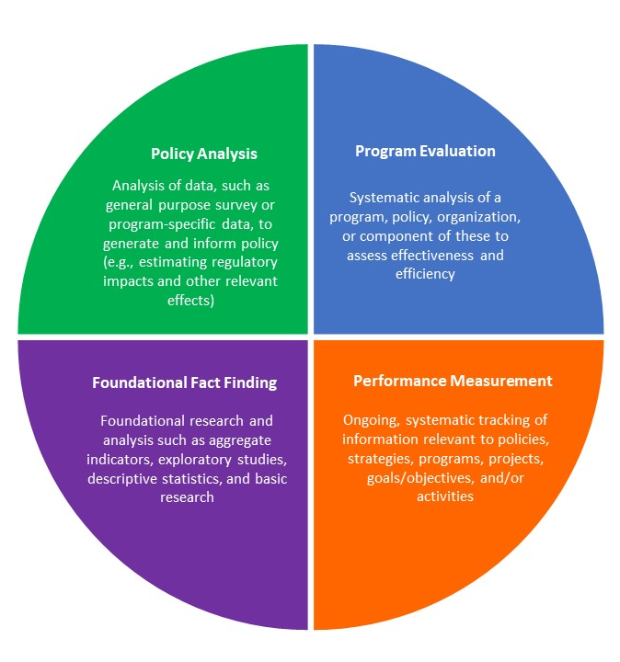
Evaluation is One Tool for Building Evidence Source: Appendix A (Components of Evidence) in Memorandum M-19-23: Phase 1 Implementation of the Foundations for Evidence-Based Policymaking Act of 2018: Learning Agendas, Personnel, and Planning Guidance. Executive Office of the President, 2019. https://www.whitehouse.gov/wp-content/uploads/2019/07/M-19-23.pdf .
20 Minute Version: Time for Discussion
Notes:
Evaluation is different from, but complements, other types of evidence building.
The first three examples are included in the Evidence Act as three types of evidence building in addition to evaluation; they are defined in M-19-23:
Performance measurement = “ongoing, systematic tracking of information relevant to policies, strategies, programs, projects, goals/objectives, and/or activities”
Foundational fact finding = “foundational research and analysis such as aggregate indicators, exploratory studies, descriptive statistics, and basic research”
Policy analysis = “analysis of data, such as general-purpose survey or program-specific data, to generate and inform policy, e.g., estimating regulatory impacts and other relevant effects”

Slide 10
Evaluations Address Questions That Can Improve Programs, Governance, and Public Trust
20 Minute Version: Time for Discussion
Find out what is working in your program, what is not working, and what can be improved, and explore new approaches
Help tell the story of your program's impact and how it affects your participants
Provide insight into process and implementation
Justify funding requests by providing evidence of effectiveness
Improve your staff’s work by identifying weaknesses as well as strengths
Improve programs and their ability to function more efficiently and effectively
Crucial for good government and responsible stewardship of public funds
Build/improve transparency and accountability
Notes:
Evaluation can answer the little questions that help you address the bigger questions.
Source: OMB.

Slide 11
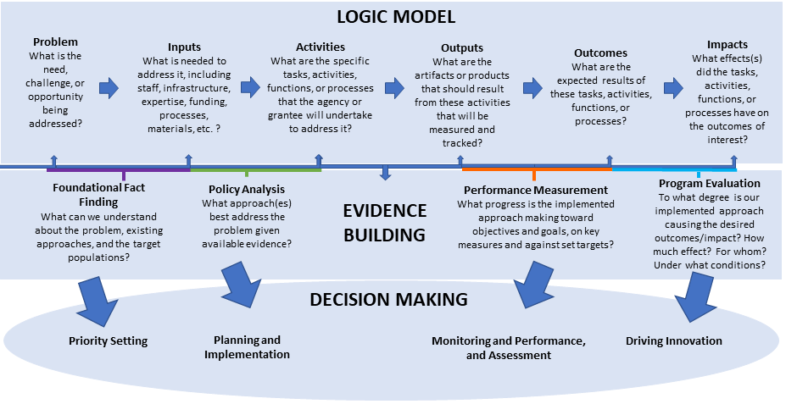
Evaluation Builds Evidence
20 Minute Version: Time for Discussion
Source: OMB, Memorandum M-21-27 (2021).
Notes:
Evaluation is one of several ways to build evidence.
This image from OMB (M-21-27, issued in 2021) depicts the information we need to assess a program or policy. This information is organized into a logic model, used to describe a program or policy (the top layer in this image). The process of building evidence, whether through fact finding, policy analysis, performance measurement, or evaluation, is shown in the middle layer of the image. At the bottom, we see how evidence can improve agency decision making.
Program evaluation looks at the expected results (outcomes) and effects (impacts) of the task, activity, function, process, or policy that we are assessing.
Sources/Acknowledgements: OMB, M-21-27 (2021); Department of Homeland Security.

Slide 12
What Questions Do You Want To Answer?
20 Minute Version: Time for Discussion
Question | Type of Evaluation
What is this program all about? Who does it serve? What is the landscape or context? | Descriptive
Should this program be fully implemented? Is it appropriate and feasible as planned? Is further evaluation feasible? | Formative
How is this program being implemented? Does it operate as intended? | Process
What changes are associated with this program? | Outcome
Does the program cause intended outcomes for participants? Was the program effective in achieving its goals, relative to a comparison group? | Impact
Notes:
Considerations in starting to discuss an evaluation:
What information do we want to find?
What questions are we looking to answer?
What type of evaluation might work for us?
Source: The Program Manager's Guide to Evaluation (hhs.gov)
Acknowledgements: OMB.

Slide 13
Evaluation Supports Continuous Quality Improvement
20 Minute Version: Time for Discussion
“Evaluation is a powerful tool for improving a program and increasing its ability to serve people more efficiently. It gives programs an opportunity to test their interventions, adjust services to best meet community needs, and collect data to support their work.”
AmeriCorps.gov
Plan
Do
Check
Act
Notes:
Evaluation applied to continuous quality improvement or CQI. One example of a CQI rubric is the plan-do-check-act cycle depicted here. The steps are as follows:
Plan –plan change to improve your program or policy
Do –implement change, starting small
Check –assess what results from making change
Act –follow through to make change based on what you learn
Sources/Acknowledgements:
Thomas, Craig, Liza Corso, and Harald Pietz. “Evaluation, Performance Management, and Quality Improvement: Understanding the Role They Play to Improve Public Health.” CDC, 2013. https://www.cdc.gov/std/products/progevalwebinar-slides.pdf .

Slide 14

How Can Evaluation Support Our Program and Agency?
20 Minute Version: Time for Discussion
Program and policy planning
Program management
Performance improvement
Communication and engagement
Coordination across offices and programs to learn from experience
Notes:
Practically speaking, the information that comes out of evaluation can serve many purposes.
Source: Department of Homeland Security.

Slide 15
How Can Our Agency Enhance Our Use of Evaluation?
20 Minute Version: Time for Discussion
What potential barriers to conducting evaluation exist at our agency?
How can we incorporate evaluation into our normal operations?
What supports exist to help us increase the use of evidence at our agency?
What are other agencies doing in terms of evaluation?
What practices can we adopt or adapt to our work?
How might incorporating evaluation into our normal operations help us reach our mission?

Slide 16
Evaluation Should Inform Decision-Making
20 Minute Version: Time for Discussion
Support agency priorities
Target resources to what works
Improve existing programs
Revamp programs that do not work as intended/ do not lead to intended outcomes
Promote efficient and effective use of public dollars
Build trust with transparency and a willingness to continually improve
Notes:
Evaluations build evidence about what works, how well, for whom.
Decisions about funding allocations may mean:
1) continue supporting effective programs;
2) discontinue support for programs that do not achieve goals;
3) Identify improvements for required programs;
4) assess pilot programs
Sources: Building and Using Evidence to Improve Government (whitehouse.gov); OMB.

Slide 17
Evaluations Used In Funding and Programmatic Decisions
20 Minute Version: Time for Discussion
Drug Abuse Resistance Education (D.A.R.E.)
The D.A.R.E. program, founded in Los Angeles in 1983, became popular across the United States in the following decade. The ensuing group of research studies conducted, including several funded by the federal government, found little to no impact of D.A.R.E. on rates of teen drug use. One randomized longitudinal field experiment that examined the effects of D.A.R.E. participation found no long-term effects and some increases in drug use after participation.
Revised versions of D.A.R.E. exist today. However, D.A.R.E. America longer receives federal funding due to the strong evidence base showing the original program’s lack of impact.
Head Start
Evidence finds that the program narrowed achievement gap in school readiness between Head Start and general preschool population. But Head Start children still left the program with below average skills and without skills and knowledge that predict student success.
Reauthorization (Improving Head Start for School Readiness Act of 2007) required low-quality providers to compete for future funding, through new evidence-based Designation Renewal System.
Notes:
Head Start example:
Research evidence, including the National Head Start Impact Study and the Head Start Family and Child Experiences Survey (FACES), found that the program narrowed the achievement gap between Head Start and the general preschool population in key elements of school readiness. But Head Start children still left the program with below average skills and without the skills and knowledge that predict student success.
When the Improving Head Start for School Readiness Act of 2007 reauthorized Head Start, a new provision required providers found to be low quality during the prior five-year grant period to compete for future funding. Re-competition aimed to improve the program and replace low-quality grantees with high-quality ones through the Designation Renewal System, also developed on the basis of research evidence.
Drug Abuse Resistance Education (D.A.R.E.) example:
The D.A.R.E. program, founded in Los Angeles in 1983, proliferated in the decade that followed. The ensuing group of research studies conducted to assess the program’s impacts found little to no impact on rates of teen drug use, including those studies funded by the Federal Government. In fact, one randomized longitudinal field experiment that examined the short- and long-term effects of D.A.R.E. participation found no long-term effects and some increases in drug use after participation.
The program still exists today. However, the nonprofit D.A.R.E. American organization that supports curriculum development and training no longer receives Federal funding due to the strong evidence base showing the original program’s lack of impact.
Sources:
Greg Berman and Aubrey Fox, “Lessons From the Battle Over D.A.R.E. The Complicated Relationship between Research and Practice,” U.S. Department of Justice, Center for Court Innovation, 2009, https://www.courtinnovation.org/sites/default/files/DARE.pdf .
D.A.R.E., https://dare.org .
Amy Nordrum, “The New D.A.R.E. Program –This One Works,” Scientific American (September 10, 2014), https://www.scientificamerican.com/article/the-new-d-a-r-e-program-this-one-works/# .
Acknowledgements: OMB.

Slide 18
What’s at Risk if We Don’t Evaluate?
20 Minute Version: Time for Discussion
We support a program or policy that does not work.
We support a program or policy that hinders agency objectives.
We may not have funds to support a program or policy that does work, if funds committed elsewhere.
We can’t demonstrate program or policy value.
We can’t show ways to improve.
Existing evidence is often limited, outdated, or can’t be generalized. Evaluation can fill key gaps in our knowledge of what works and why.
Notes:
Missing the chance to evaluate a program or policy can be costly. We can lose the support of leadership if we do not have evidence to back up claims that a program or policy is effective. We may end up working at cross purposes to agency goals. And the opportunity costs can be considerable, in terms of staff, time, and funds that could be better used for programs that work. Supporting a program or policy that does not work represents poor stewardship of taxpayer funds.
Sources: OMB.

Slide 19

Evaluation is a Key Agency Function
20 Minute Version: Time for Discussion
Program evaluation is a key agency function to support its mission. Agencies are required to make the investments needed to support evaluation:
Planning
Time
Funding
Staff
Sources: Foundations for Evidence-Based Policymaking Act of 2018 (Public Law 115-435); Memorandum M-21-2 (OMB); Memorandum M-19-23 (OMB).
Notes:
Federal evaluation requirements are included in:
Foundations for Evidence-Based Policymaking Act (Evidence Act)
Government Performance and Results Act Modernization Act (GPRAMA)
Office of Management and Budget (OMB) Guidance
Sources/Acknowledgements: OMB.

Slide 20
How We Find Resources for Evaluation
20 Minute Version: Time for Discussion
Time
Move quickly (rapid cycle or formative evaluation) while planning for longer-term
Money
Use existing data
Staff
Leverage existing knowledge inside/outside of agency
Build evaluation requirements into funding announcements
Save time by considering evaluation at outset
Use inhouse expertise
Make evaluation part of normal operations
Save money by considering evaluation at outset
Use extensive federal resources
Partner with outside organizations
Notes:
Time
Rapid evaluation methods allow for collecting, analyzing, and responding to data in a compressed timeframe while planning for something longer-term
Formative evaluations may be able to move more quickly and use generic information collections
Money
Evaluations should be part of normal operations
Evaluation can be lower-cost and shorter-term; limited resources should be targeted.
Expertise
Capacity can be built with support from the agency’s Evaluation Officer, other agency offices for research and evaluation (e.g., ASPE, OPRE), evaluation resources at other federal agencies, and partnerships with outside organizations.
Tools on MAX and Evaluation.gov
Sources: OMB; The Program Manager’s Guide to Evaluation, 2nd edition, at https://www.acf.hhs.gov/sites/default/files/documents/opre/program_managers_guide_to_eval2010_508.pdf .

Slide 21
Getting Started: Planning an Evaluation
20 Minute Version: Time for Discussion
What Do You Need to Know?
Goal for the Evaluation
Audience(s)
Timeframe
How Findings Will Be Used
Funding Source(s)
Estimated Funding Needed
Notes:
This is a template that you can use to present key information about the evaluation that you propose.

Slide 22
Initiating an Evaluation: Six Questions
20 Minute Version: Time for Discussion
1. Why is this evaluation being initiated?
2. Who has key information about the program that could inform the evaluation?
3. Can the program identify and connect activities and anticipated outcomes or changes?
4. What are the goals of the evaluation?
5. When and how does data need to be collected, analyzed, and shared?
6. What resources are needed to evaluate?
Notes:
See Initiating an Evaluation, a tipsheet resource posted in The Federal Evaluation Toolkit for more details on using each question to facilitate and document decision-making.

Slide 23
Questions?

Slide 24
Acknowledgments
The Federal Evaluation Toolkit
Partners
Danielle Berman (Office of Management and Budget)
Lauren Deutsch (Office of Management and Budget)
Diana Epstein (Office of Management and Budget)
Susan Jenkins (Office of the Assistant Secretary for Planning and Evaluation)
Daniel Kim (Office of the Assistant Secretary for Planning and Evaluation)
Erika Liliedahl (Office of Management and Budget)
Erica Zielewski (Office of Management and Budget)
Steering Committee
Kelly Bidwell (General Services Administration)
Kriti Jain (Administration for Children and Families)
Dan Kidder (Centers for Disease Control and Prevention)
Rebecca Kruse (Department of Homeland Security)

